Slide 1

Binary Tree

Slide 2
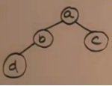
Binary Tree
Binary Tree – Every node can have at most 2 children
Example:

Slide 3
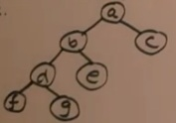
Full Binary Tree
Full Binary Tree – Every node (except leaf nodes) have exactly 2 children
Example:

Slide 4
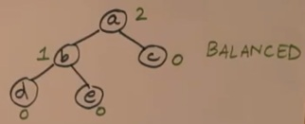
Balanced Binary Tree (1)
Balanced Binary Tree – No two siblings can have a height difference of more than 1
Example:

Slide 5
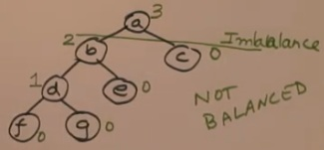
Balanced Binary Tree (2)
Imbalanced Binary Tree – There are two siblings can have a height difference of more than 1
Example:

Slide 6
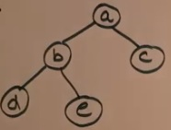
Implementation of Binary Tree
How to implement tree structure in the program code
Example:

Slide 7
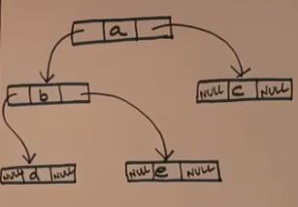
Implementation of Binary Tree (2)
1. Concept of Linked list: to store data element in the nodes
Every element has 2 pointers: right and left pointer It is recommended practice to make program/ function easier to write
Example:

Slide 8
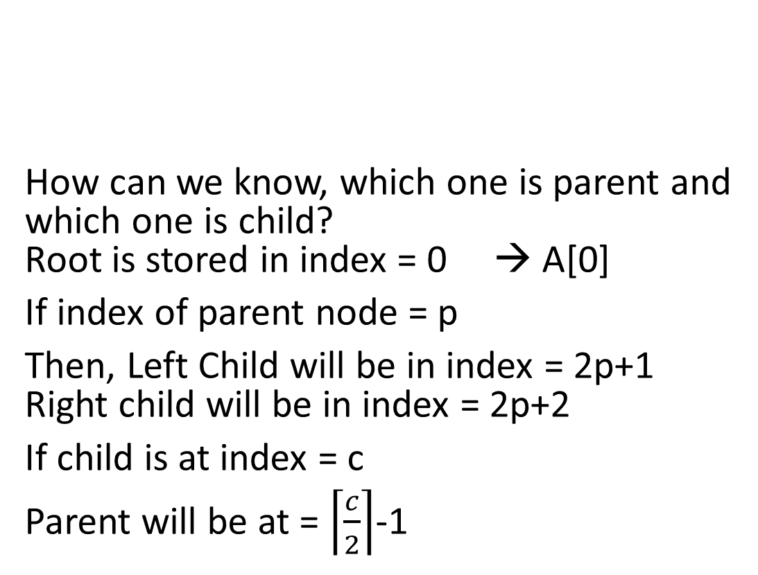
Implementation of Binary Tree (3)
2. Concept of Array
Example:
How can we know, which one is parent and which one is child? Root is stored in index = 0 → A[0]
If index of parent node = p
Then, Left Child will be in index = 2p+1 Right child will be in index = 2p+2
If child is at index = c
Parent will be at = $\left\lceil \frac{c}{2}\right\rceil$-1
A
B
C
D
E
0
1
2
3
4
5
6

Slide 9
Example 1
Pohon binary dapat digunakan untk menggambarkan pernyataan aritmatika:
(A + B) x C – D/E + F

Slide 10
Langkah-langkah
Ambil titik akarnya yaitu operator ‘-’
Ini membagi pernyataan aritmatika tersebut menjadi left child dan right child
Sekarang fokus ke left child, ternyata operator ‘x’ memisahkan (A+B) di ruas kiri dan C di ruas kanan
Di ruas kiri level paling bawah, terdapat operator ‘+’ yang memisahkan A di ruas kiri dan B di ruas kanan
Cara yang sama kemudian berlaku juga untuk right child dari atas sampai ke bawah

Slide 11
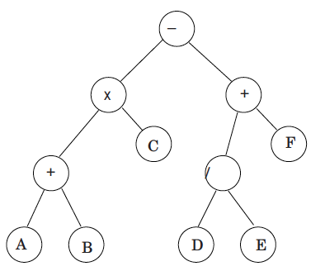
Binary tree
(A + B) x C – D/E + F

Slide 12
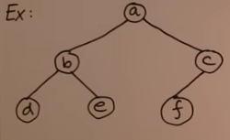
Tree Traversal
Tree traversal means the way to visit all nodes of the binary tree in order
3 parts to any binary tree:
Root
Left sub tree
Right sub tree

Slide 13
Tree Traversal (1)
There are 3 method to travers the binary tree:
Pre-Order Method
Root – Left Sub Tree – Right Sub Tree
- In Order Method
Left sub tree - Root - Right sub tree
Post-Order Method
Left sub tree - Right sub tree – Root
Link of Learning Resource: https://www.youtube.com/watch?v=8v6qxmcEly8&t=352s

Slide 14
Exercise 1
For the binary tree in slide 10, find the order of nodes acc. to:
Pre-Order Method
Root – Left Sub Tree – Right Sub Tree
- In Order Method
Left sub tree - Root - Right sub tree
Post-Order Method
Left sub tree - Right sub tree - Root

Slide 15
Exercise 2
If the order of nodes according to Post-Order Method is as follows:
A B + C x E F / D - x
Find the binary Tree
Find the order of nodes according to Pre-Order Method and In Order Method

